Slide 1
COMP 4332 / RMBI 4310 Big Data Mining (Spring 2020)
Tutorial 6 Random Walk Based Network Embeddings
TA: Xin Liu (xliucr@connect.ust.hk)

Slide 2
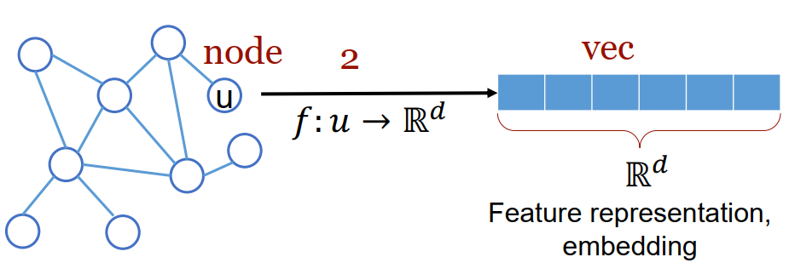
Network Representations
Goal: efficient task-independent feature learning for machine learning in networks.

Slide 3
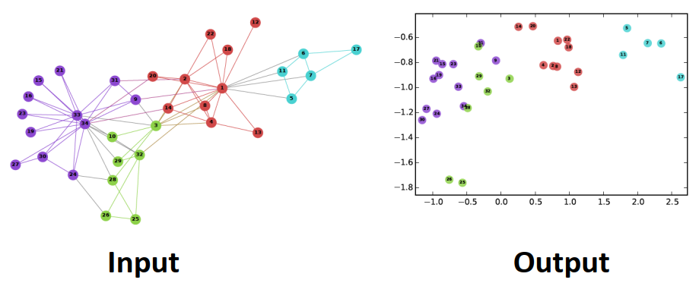
Network Representations
Intuition: find embedding of nodes to d-dimensions so that “similar” nodes in the graph have embeddings that are close together.
Perozzi, Bryan, Rami Al-Rfou, and Steven Skiena. "Deepwalk: Online learning of social representations." In KDD, pp. 701-710. 2014.

Slide 4
Applications
Link Prediction
Node Classification
Recommendation
Visualization

Slide 5
Work in the History
ISOMap [Tenenbaum et al., Science’00]
LLE [Roweis and Saul, Science’00]
Laplacian EigenMap [Belkin et al., NIPS’01]
(t)-SNE [Maaten and Hinton, JMLR’08]
Deepwalk [Perozzi et al., KDD’14]
LINE [Tang et al., WWW’15]
Node2vec [Grover and Leskovec, KDD’16]

Slide 6
General Idea
$$Z_{u}Z_{v}≈P\{u,v co_occur on a random walk\}$$
Estimate the probability of visiting node v on a random walk starting from node u using some random walk strategy R.
Optimize embeddings to encode these random walk statistics.
Convert graph into list of nodes
Train embedding with Word2Vec

Slide 7
Why using Random Walks
Expressivity: Flexible stochastic definition of node similarity that incorporates both local and higher-order neighborhood information.
Efficiency: Do not need to consider all node pairs when training; only need to consider pairs that co-occur on random walks.

Slide 8
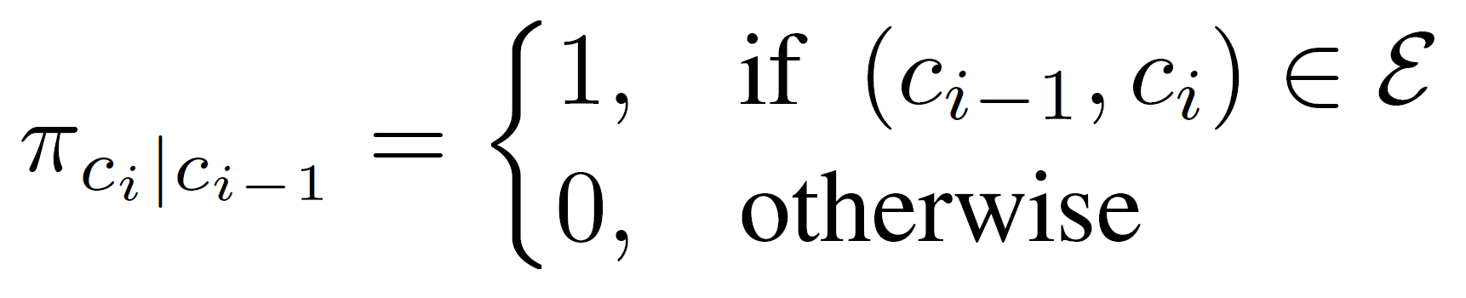
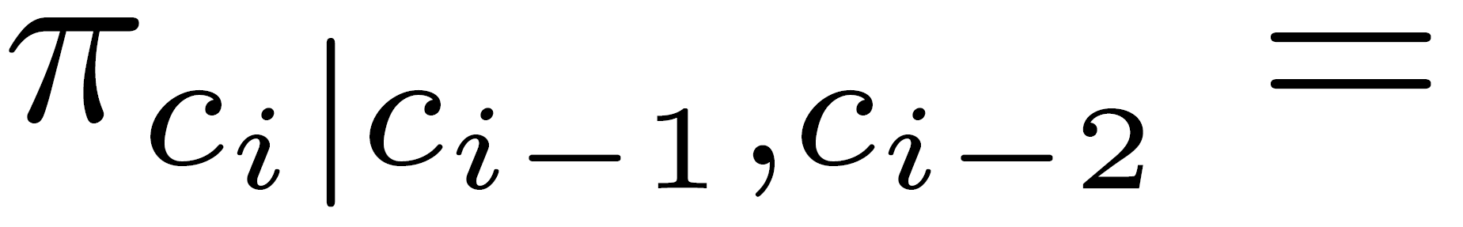


First-order Random Walk
A random walker moves to next node based on the last node.
Second Last Node
Last Node
Node
Perozzi, Bryan, Rami Al-Rfou, and Steven Skiena. "Deepwalk: Online learning of social representations." In KDD, pp. 701-710. 2014.

Slide 9
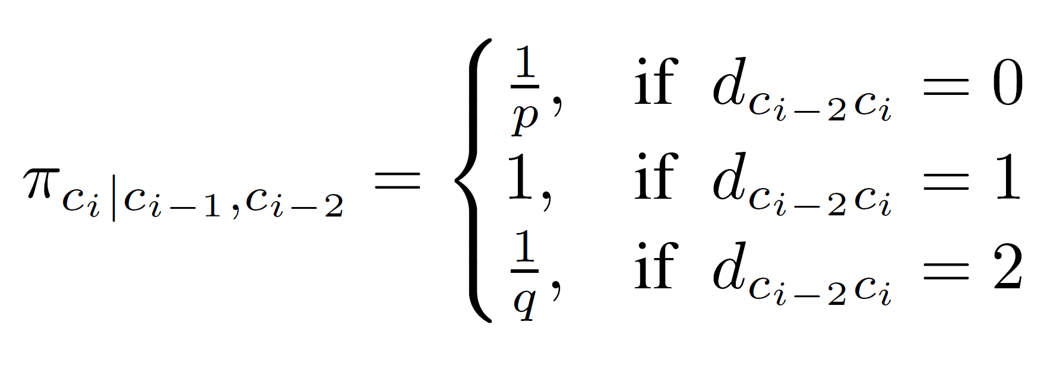



Second-order Random Walk
A random walker moves to next node based on the last two nodes.
$$\frac{1}{p}$$
$$\frac{1}{q}$$
Second Last Node
B
Last Node
$$1$$
A
Node
Grover, Aditya, and Jure Leskovec. "node2vec: Scalable feature learning for networks." In KDD, pp. 855-864. 2016.

Slide 10
Pipeline
Data loader
Random walk generator
Embedding algorithm
Scorer

Slide 11
Implementation of the Whole Pipeline
See the jupyter-notebook.

Slide 12
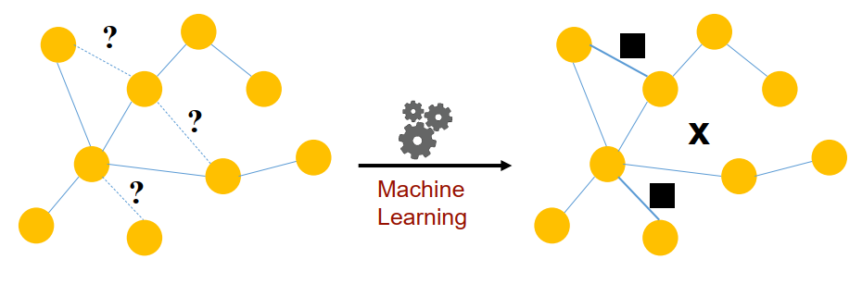
Link Prediction
Predict the relation between nodes with their cosine similarity and calculate the AUC-ROC score.

Slide 13
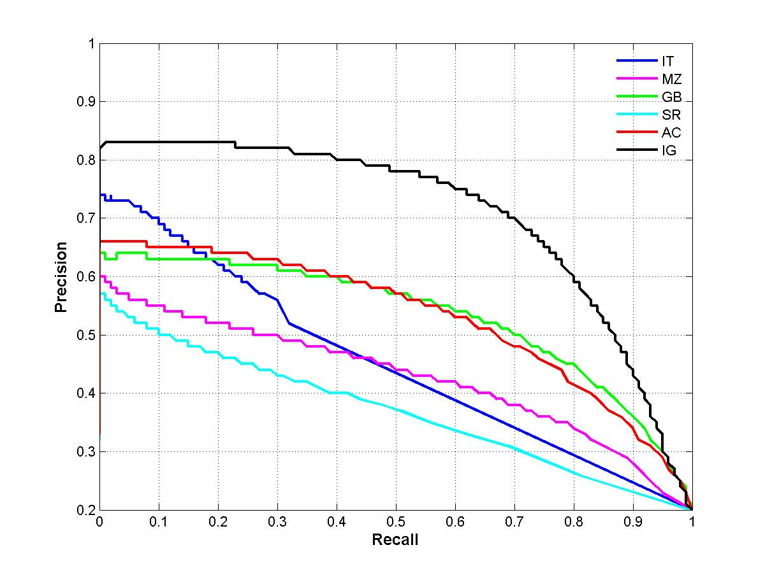
AUC-ROC Score
Area Under Curve (AUC) – ROC (Receiver Operating Characteristic Curve)
Under each recall level, we prefer a higher precision

Slide 14
Implementation of the Link Prediction Task
See the jupyter-notebook.

Slide 15
Thank You

